Slide 1
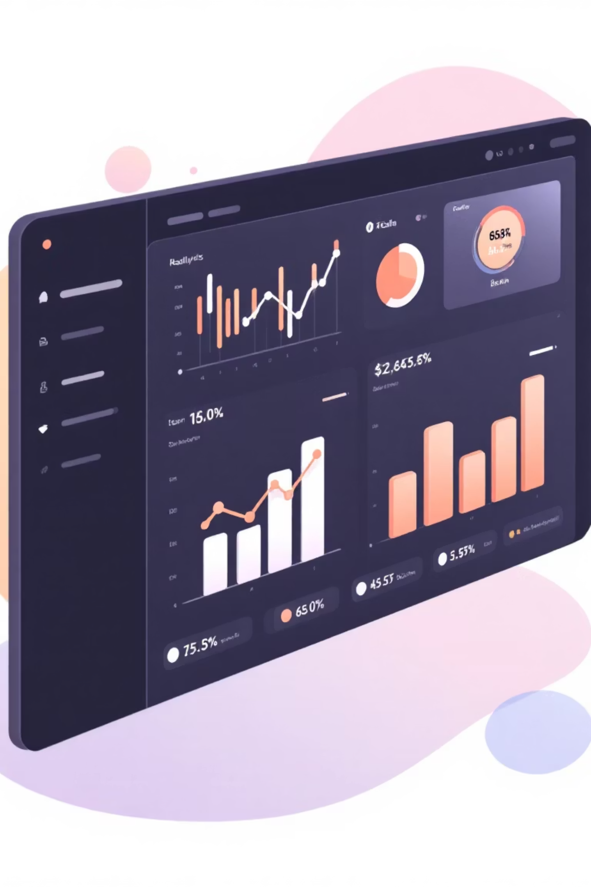
Customer Shopping Behavior Analysis
Analyzing 3,900 transactions across product categories to uncover spending patterns, customer segments, and strategic insights for data-driven business decisions.

Slide 2
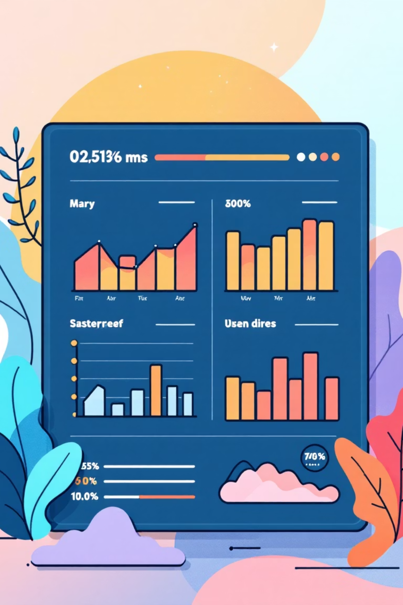
Dataset Overview
3,900
18
37
Total Transactions
Data Features
Missing Values
Columns tracking behavior
In Review Rating column
Purchase records analyzed
Key features include customer demographics (age, gender, location, subscription status), purchase details (items, category, amount, season), and shopping behavior (discounts, promo codes, purchase frequency, ratings, shipping type).

Slide 3

Data Preparation & Cleaning
Python Analysis Steps
Loaded dataset using pandas
Explored structure with df.info() and df.describe()
Imputed missing Review Ratings using median by category
Standardized columns to snake_case
Created age_group and purchase_frequency_days features
Dropped redundant promo_code_used column
Connected Python to MySQL and loaded cleaned data for structured business analysis.

Slide 4

Revenue Insights
Gender Revenue Comparison
Male and female customers show comparable spending patterns across all product categories.
High-Spending Discount Users
43 customers used discounts but still spent above average, ranging from $60-$100 per purchase.

Slide 5
Product Performance
1
2
3
Gloves
Sandals
Boots
3.86 average rating
3.84 average rating
3.82 average rating
4
5
Hat
Skirt
3.80 average rating
3.78 average rating
Top-rated products show strong customer satisfaction, with accessories and footwear leading in reviews.

Slide 6
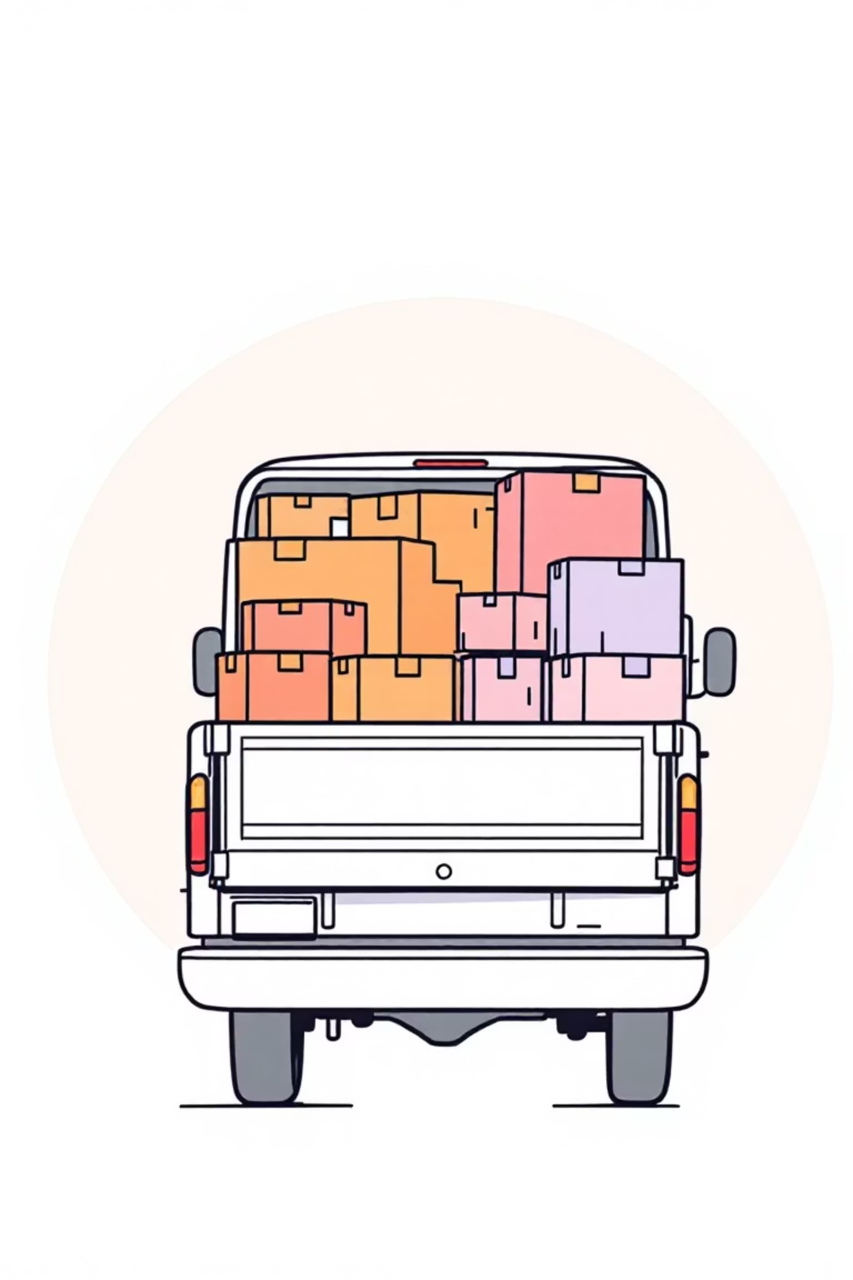
Shipping & Subscription Analysis
Shipping Type Comparison
Subscriber vs. Non-Subscribers
Express: $60.48 average purchase
Subscribers: 1,053 customers, $59.49 avg spend, $62,645 total revenue
Standard: $58.46 average purchase
Non-Subscribers: 2,847 customers, $59.87 avg spend, $170,436 total revenue
Express shipping customers spend slightly more per transaction.

Slide 7
Discount Strategy Insights
50%
49.66%
49.07%
Hat
Sneakers
Coat
Highest discount rate
48.17%
47.37%
Sweater
Pants
These products show highest percentage of discounted purchases, indicating discount-dependent demand.

Slide 8




Customer Segmentation
Returning Customers
701 customers (18.0%)
Moderate engagement
Loyal Customers
3,116 customers (79.9%)
Highest purchase frequency
New Customers
83 customers (2.1%)
First-time buyers
Strong loyal customer base presents opportunity to convert returning customers into loyal segment. Only 958 of 3,476 repeat buyers (>5 purchases) are subscribers.

Slide 9
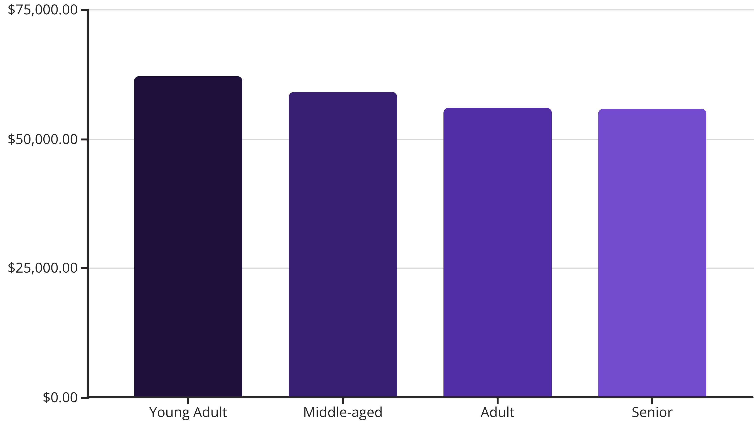
Revenue by Age Group
Young adults generate highest revenue ($62,143), followed closely by middle-aged customers ($59,197). Revenue distribution is relatively balanced across age groups.

Slide 10
Strategic Recommendations
Boost Subscriptions
Loyalty Programs
Review Discount Policy
Promote exclusive benefits to convert repeat buyers into subscribers
Reward returning customers to move them into loyal segment
Balance sales boosts with margin control for discount-dependent products
Product Positioning
Targeted Marketing
Highlight top-rated and best-selling items in marketing campaigns
Focus on high-revenue age groups and express-shipping users

